Slide 1
Name Artist & Title
Game 018
Starship – Sara
Twenty One Pilots – Heathens
Icona Pop ft Charlie X – I Love It
Maxine Nightengale – Right Back Where We Started From
Natalie Merchant – Carnival
Styx – Show Me The Way
Quiet Riot – Cum On Feel The Noize
Frankie Valli – Grease
Dean Martin – Everybody Loves Somebody
Elle King – Exs & Ohs

Slide 2
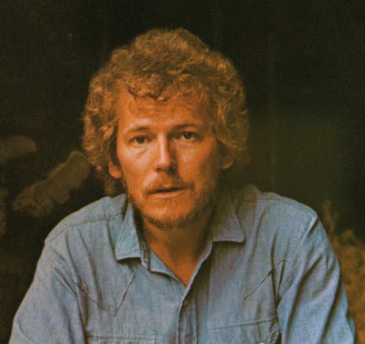
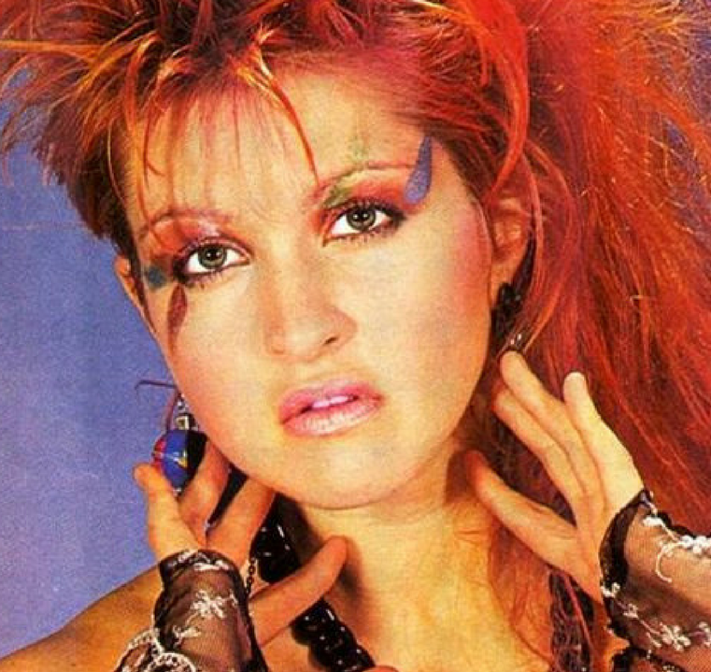
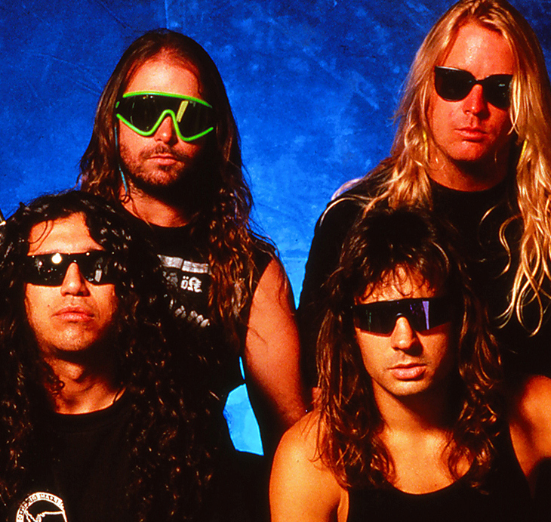
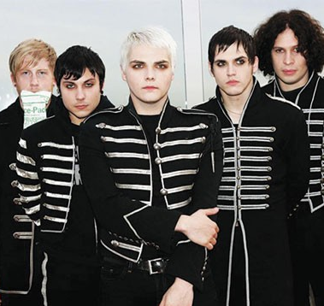
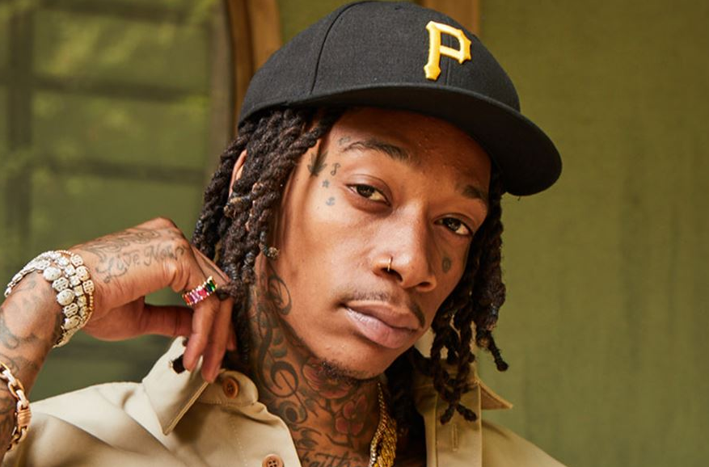
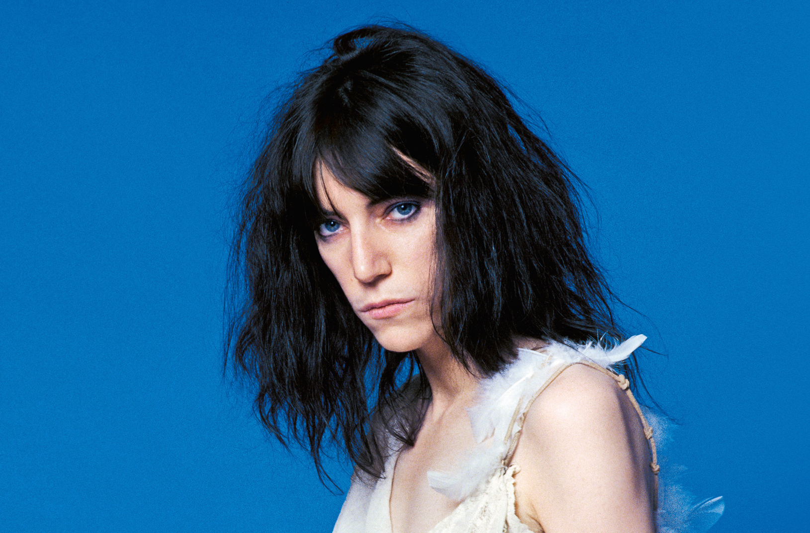
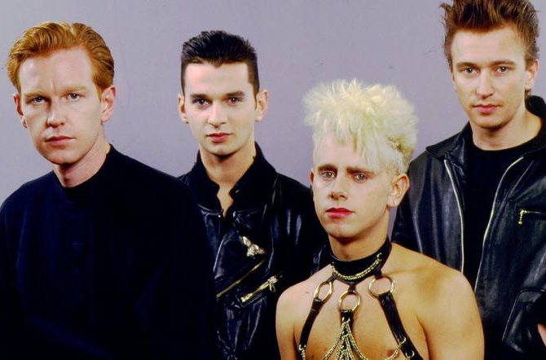
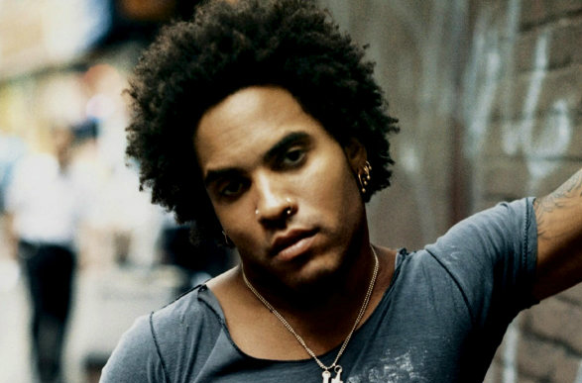
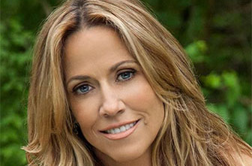
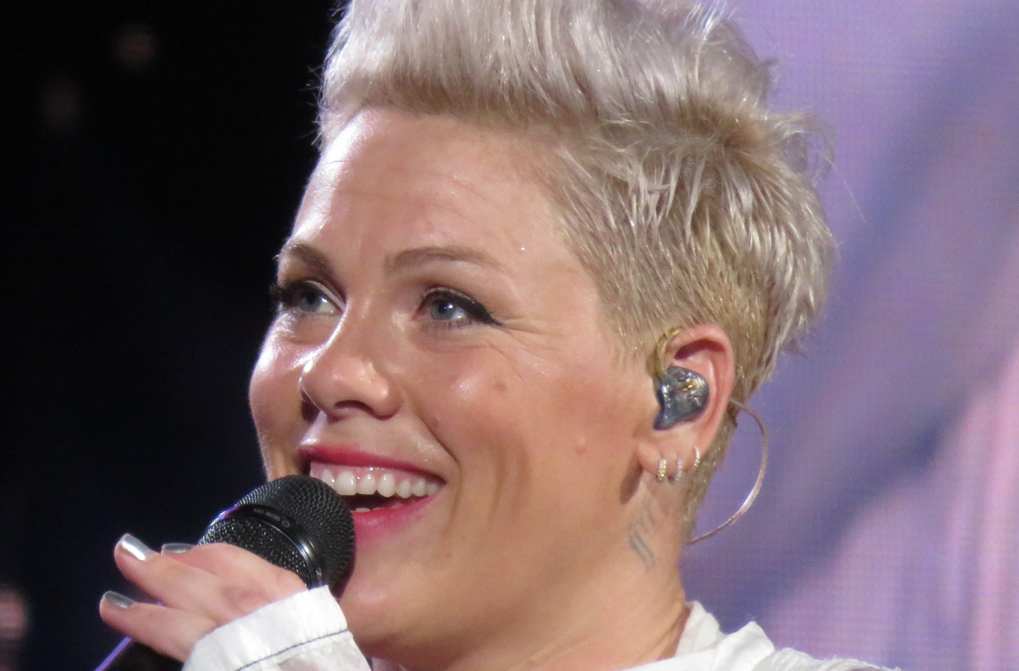
Picture Round
Instructions: Identify the artist or group on the line under each image

Slide 3
Decades In what decade was this version of the song originally released?
Bob Marley – One Love (1965)
Harry Styles – Watermelon Sugar (2019)
The Verve Pipe – The Freshman (1996)
Gonna Fly Now (Rocky Theme) – Bill Conti (1976)
Wreckx-n-Effect – Rump Shaker (1992)
Samantha Fox – Naughty Girls Need Love Too (1987)
Marren Morris – Them Bones (2019)
Blondi – Rapture (1980)
The Hollies – Long Cool Woman In A Black Dress (1972)
50 Cent – Disco Inferno (2004)
None

Slide 4
General Knowledge
The voices of Franki Valli, Luciano Pavarotti, and Sam Smith all fall within what vocal range, the highest male range within the modal register? Tenor
In 2020, what founder of the Parliament-Funkadelic collective competed in Season 8 of The Masked Singer before being eliminated on “Hall of Fame Night”? George Clinton
What 1984 duet by a former member of Genesis and a former member of Earth, Wind & Fire appeared on both their solo albums, was a #1 hit in several countries, and sold over a million copies in the U.S.? Easy Lover (Phil Collins from Genesis and Philip Bailey from Earth, Wind & Fire)
The doodle of a modified smiley face with X’s for eyes, a wobby smile, and a tongue hanging out is one of the most enduring images of what band’s career, adorning t-shirts, mugs, koozies, key rings and many other items? Nirvana’s
Which Star Search, Mickey Mouse Club, and boy band alum has Billboard named “the best-performing male solo artist in the history of the Mainstream Top 40”? Justin Timberlake
What is the term for the type of musical in which most of the songs are already well-known and popular, as opposed to a standard musical, whose music is original to the show? Jukebox musical
Love Hangover was a 1976 #1 solo hit on the Billboard Hot 100 and Hot Selling Soul Singles for what legendary singer, whose career began with two other women in Detroit in 1959? Diana Ross (from The Supremes)
What are the first and last names of two of MTV’s five original VJs? Nina Blackwood, Mark Goodman, Alan Hunter, JJ Jackson, Martha Quinn
Name the only single released from comedian Denis Leary’s 1993 album No Cure for Cancer. Asshole
From what band’s 2003 album My Private Nation did the song Calling All Angels become their third Top 20 hit? Train
Widely considered to be one of the most influential works of the 20th century, Igor Stravinksy’s avant-guarde ballet and orchestral work The Rite of Spring caused a ”near-riot” reaction when it was first performed in 1913 in France . How many minutes long is The Rite of Spring? 35 minutes

Slide 6
Gordon Lightfoot
Cyndi Lauper
Slayer
My Chemical Romance
Wiz Khalifa
Patti Smith
Depeche Mode
Lenny Kravitz
Sheryl Crow
P!nk

